Slide 1
Symbolic Execution
Willem Visser
Stellenbosch University

Slide 2
Overview
What is Symbolic Execution
History of Symbolic Execution
Symbolic PathFinder
Concolic Execution aka Dynamic SE
DSE vs classic SE
RW 745 - Willem Visser

Slide 3
Acknowledgements
Corina Pasareanu
My ex-colleague from NASA Ames and
probably the world’s leading expert on symbolic execution, for doing this
YouTube video (Symbolic Execution and Model Checking for Testing)
and for putting the presentation on how JPF’s symbolic execution now works on the web
at http://www.slideworld.com/slideshows.aspx/Symbolic-Execution-of-Java-Bytecode-ppt-823844
RW 745 - Willem Visser

Slide 4
What is Symbolic Execution?
Static Analysis Technique
  Executes code in a non-standard way
Instead of concrete inputs, symbolic values are manipulated
At each program location, the state of the system is defined by
  The current assignments to the symbolic inputs and local variables
    A symbolic state represent a set of concrete states
  A path condition that must hold for the execution to reach this location
    Condition on the inputs to reach the location
  Program counter
At each branch in the code, both paths must be followed
  On the true branch: the condition is added to the path condition
  On the false branch: the negation of the condition is added to the path condition
  If a branch is infeasible, then execution along that branch is terminated
Idea first floated in mid 1970s

Slide 5
Symbolic Execution: Walking Many Paths at Once
[pres = 460;pres_min = 640;pres_max = 960]
if( (pres < pres_min) || (pres > pres_max)) {
…
} else {
…
}
[pres = X;pres_min = MIN;pres_max = MAX] [PC: TRUE]
if ((pres < pres_min) ||
(pres > pres_max)) {
…
} else {
…
}
if ((pres < pres_min)) ||
(pres > pres_max)) {
…
} else {
…
}
if ((pres < pres_min) ||
(pres > pres_max)) {
…
} else {
…
}
[PC: X< MIN]
[PC: X > MAX]
[PC: X >= MIN &&
X <= MAX

Slide 6
Concrete Execution Path (example)
int x, y;
if (x > y) {
x = x + y;
y = x – y;
x = x – y;
if (x > y)
assert(false);
}
x = 1, y = 0
1 >? 0
x = 1 + 0 = 1
y = 1 – 0 = 1
x = 1 – 1 = 0
0 >? 1

Slide 7
Symbolic Execution Tree (example)
int x, y;
if (x > y) {
x = x + y;
y = x – y;
x = x – y;
if (x > y)
assert(false);
}
x = X, y = Y
X >? Y
[ X <= Y ] END
[ X > Y ] x = X + Y
[ X > Y ] y = X + Y – Y = X
[ X > Y ] x = X + Y – X = Y
[ X > Y ] Y >? X
[ X > Y, Y <= X ] END
[ X > Y, Y > X ] END

Slide 8
History of Symbolic Execution
1975-76
  James King
  Lori Clarke
1980-2003
  Nothing much happened
Major improvement in SAT solving + Moore’s Law
2003 Generalized Symbolic Execution
  Classic King/Clarke style but for modern programming language, namely Java
2005 DART (Directed Automated Random Testing)
  First concolic/DSE system

Slide 9
Popular SE Systems
Dynamic Symbolic Execution
  CUTE (C) and jCUTE (Java)
  CREST (C)
  PEX (.NET)
  SAGE (x86 binaries)
  [New] Jalangi (JavaScript)
Classic Symbolic Execution
  KLEE (C)
  Symbolic PathFinder (Java)

Slide 10
Generalized Symbolic Execution
2003 Khurshid, Pasareanu, Visser
Main idea is how to handle complex data structures
Secondary was the use of model checking as an underlying infrastructure for symbolic execution

Slide 11
Data Structure Example
NullPointerException
class Node {
int elem;
Node next;
Node swapNode() {
if (next != null)
if (elem > next.elem) {
Node t = next;
next = t.next;
t.next = this;
return t;
}
return this;
}
}
Input list +
Constraint
Output list
?
null
none
?
null
E0
none
E0
E0
E1
E0 <= E1
E0
E1
E0
E1
null
E0 > E1
E1
E0
null
E0
E1
E0 > E1
E1
E0
E0
E1
E0 > E1
E1
E0
E0
E1
?
E0 > E1
E1
E0
?

Slide 12
Lazy Initialization Algorithm
consider executing
next = t.next;
next
next
E0
E1
t
Precondition: acyclic list
next
next
next
next
next
next
next
E0
E1
null
E0
E1
?
E0
E1
E0
next
E1
t
t
t
next
t
next
next
next
next
next
E0
E1
null
E0
E1
?
t
t

Slide 13
JPF Symbolic Execution
JPF-SE
  Original approach based on program transformation
  2003-2007
SPF (Symbolic JPF)
  Based on non-standard bytecode interpretation
  2008-…
  Rest of the presentation focus on this
RW 745 - Willem Visser

Slide 14
Symbolic JPF
JPF search engine used
  To generate and explore the symbolic execution tree
  Also used to analyze thread inter-leavings and other forms of non-determinism that might be present in the code
  No state matching performed
    In general, un-decidable
  To limit the (possibly) infinite symbolic search state space resulting from loops, we put a limit on
    The model checker’s search depth or
    The number of constraints in the path condition
Off-the-shelf decision procedures/constraint solvers used to check path conditions
  Model checker backtracks if path condition becomes infeasible
  Generic interface for multiple decision procedures
    Choco (for linear/non-linear integer/real constraints, mixed constraints),
  http://sourceforge.net/projects/choco/
    IASolver (for interval arithmetic) http://www.cs.brandeis.edu/~tim/Applets/IAsolver.html
Notes:
Say we use omega library

Slide 15
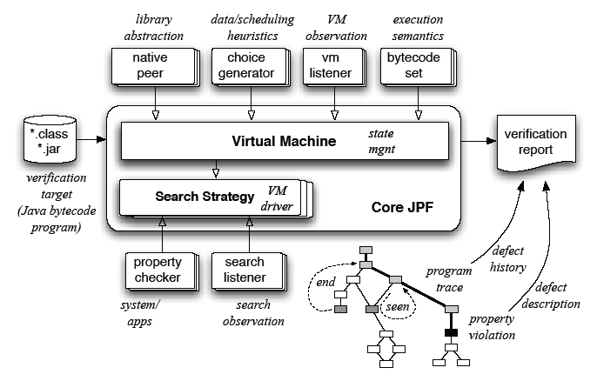
Implementation
Key mechanisms:
  JPF’s bytecode instruction factory
    Replace or extend standard concrete execution semantics of byte-codes with non-standard symbolic execution
  Attributes associated w/ program state
    Stack operands, fields, local variables
    Store symbolic information
    Propagated as needed during symbolic execution
Other mechanisms:
  Choice generators:
    For handling branching conditions during symbolic execution
  Listeners:
    For printing results of symbolic analysis (method summaries)
    For enabling dynamic change of execution semantics (from concrete to symbolic)
  Native peers:
    For modeling native libraries, e.g. capture Math library calls and send them to the constraint solver
JPF Structure:
Instruction
Factory

Slide 16
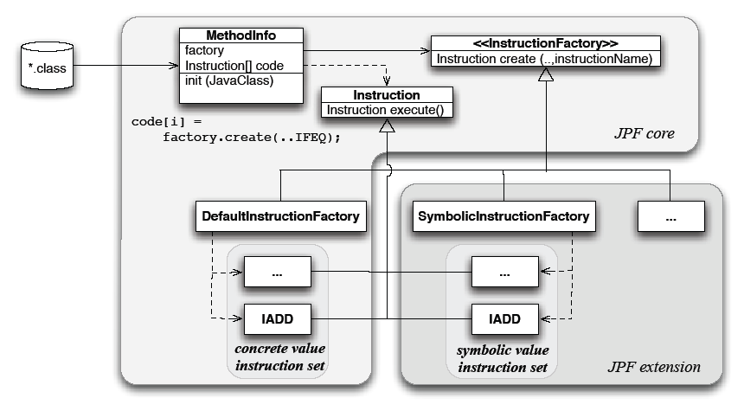
An Instruction Factory for Symbolic Execution of Byte-codes
We created SymbolicInstructionFactory
  Contains instructions for the symbolic interpretation of byte-codes
  New Instruction classes derived from JPF’s core
  Conditionally add new functionality; otherwise delegate to super-classes
  Approach enables simultaneous concrete/symbolic execution
JPF core:
  Implements concrete execution semantics based on stack machine model
  For each method that is executed, maintains a set of Instruction objects created from the method byte-codes
  Uses abstract factory design pattern to instantiate Instruction objects

Slide 17
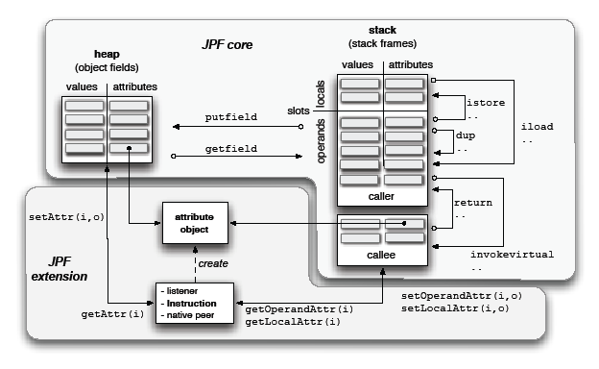
Attributes for Storing Symbolic Information
Used previous experimental JPF extension of slot attributes
  Additional, state-stored info associated with locals & operands on stack frame
Generalized this mechanism to include field attributes
Attributes are used to store symbolic values and expressions created during symbolic execution
Attribute manipulation done mainly inside JPF core
  We only needed to override instruction classes that create/modify symbolic information
  E.g. numeric, compare-and-branch, type conversion operations
Sufficiently general to allow arbitrary value and variable attributes
  Could be used for implementing other analyses
  E.g. keep track of physical dimensions and numeric error bounds or perform concolic execution
Program state:
  A call stack/thread:
    Stack frames/executed methods
    Stack frame: locals & operands
  The heap (values of fields)
  Scheduling information

Slide 18
Handling Branching Conditions
Symbolic execution of branching conditions involves:
  Creation of a non-deterministic choice in JPF’s search
  Path condition associated with each choice
  Add condition (or its negation) to the corresponding path condition
  Check satisfiability (with Choco or IASolver)
  If un-satisfiable, instruct JPF to backtrack
Created new choice generator
public class PCChoiceGenerator
extends IntIntervalGenerator {
PathCondition[] PC;
…
}

Slide 19
Example: IADD
Concrete execution of IADD byte-code:
Symbolic execution of IADD byte-code:
public class IADD extends Instruction { …
public Instruction execute(… ThreadInfo th){
int v1 = th.pop();
int v2 = th.pop();
th.push(v1+v2,…);
return getNext(th);
}
}
public class IADD extends
….bytecode.IADD { …
public Instruction execute(…
ThreadInfo th){
Expression sym_v1 = ….getOperandAttr(0);
Expression sym_v2 = ….getOperandAttr(1);
if (sym_v1 == null && sym_v2 == null)
// both values are concrete
return super.execute(… th);
else {
int v1 = th.pop();
int v2 = th.pop();
th.push(0,…); // don’t care
…
….setOperandAttr(Expression._plus(
sym_v1,sym_v2));
return getNext(th);
}
}
}

Slide 20
Example: IFGE
Concrete execution of IFGE byte-code:
Symbolic execution of IFGE byte-code:
public class IFGE extends Instruction { …
public Instruction execute(… ThreadInfo th){
cond = (th.pop() >=0);
if (cond)
next = getTarget();
else
next = getNext(th);
return next;
}
}
public class IFGE extends
….bytecode.IFGE { …
public Instruction execute(…
ThreadInfo th){
Expression sym_v = ….getOperandAttr();
if (sym_v == null)
// the condition is concrete
return super.execute(… th);
else {
PCChoiceGen cg = new PCChoiceGen(2);…
cond = cg.getNextChoice()==0?false:true;
if (cond) {
pc._add_GE(sym_v,0);
next = getTarget();
}
else {
pc._add_LT(sym_v,0);
next = getNext(th);
}
if (!pc.satisfiable()) … // JPF backtrack
else cg.setPC(pc);
return next;
} } }

Slide 21
How to Execute a Method Symbolically
JPF run configuration:
+vm.insn_factory.class=gov.nasa.jpf.symbc.SymbolicInstructionFactory
+jpf.listener=gov.nasa.jpf.symbc.SymbolicListener
+vm.peer_packages=gov.nasa.jpf.symbc:gov.nasa.jpf.jvm
+symbolic.dp=iasolver
+symbolic.method=UnitUnderTest(sym#sym#con)
Main
Symbolic input globals (fields) and method pre-conditions can be specified via user annotations
Instruct JPF to use symbolic byte-code set
Print PCs and method summaries
Use symbolic peer
package for Math library
Use IASolver as a decision procedure
Method to be executed symbolically (3rd parameter left concrete)
Main application class
containing method under test

Slide 22
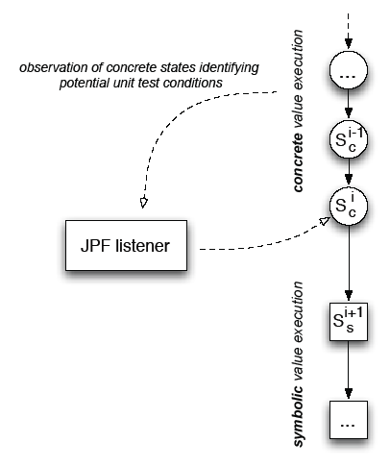
“Any Time” Symbolic Execution
Symbolic execution
  Can start at any point in the program
  Can use mixed symbolic and concrete inputs
  No special test driver needed – sufficient to have an executable program that uses the method/code under test
Any time symbolic execution
  Use specialized listener to monitor concrete execution and trigger symbolic execution based on certain conditions
Unit level analysis in realistic contexts
  Use concrete system-level execution to set-up environment for unit-level symbolic analysis
Applications:
  Exercise deep system executions
  Extend/modify existing tests: e.g. test sequence generation for Java containers

Slide 23
Case Study:
Onboard Abort Executive (OAE)
Prototype for CEV ascent abort handling being developed by JSC GN&C
Currently test generation is done by hand by JSC engineers
JSC GN&C requires different kinds of requirement and code coverage for its test suite:
  Abort coverage, flight rule coverage
  Combinations of aborts and flight rules coverage
  Branch coverage
  Multiple/single failures

Slide 24
OAE Structure
Inputs
Checks Flight Rules
to see if an abort must occur
Select Feasible Aborts
Pick Highest Ranked Abort

Slide 25
Results for OAE
Baseline
  Manual testing: time consuming (~1 week)
  Guided random testing could not cover all aborts
Symbolic JPF
  Generates tests to cover all aborts and flight rules
  Total execution time is < 1 min
  Test cases: 151 (some combinations infeasible)
  Errors: 1 (flight rules broken but no abort picked)
  Found major bug in new version of OAE
  Flight Rules: 27 / 27 covered
  Aborts: 7 / 7 covered
  Size of input data: 27 values per test case
Flexibility
  Initially generated “minimal” set of test cases violating multiple flight rules
  OAE currently designed to handle single flight rule violations
  Modified algorithms to generate such test cases

Slide 26
Generated Test Cases and Constraints
Test cases:
  // Covers Rule: FR A_2_A_2_B_1: Low Pressure Oxodizer Turbopump speed limit exceeded
  // Output: Abort:IBB
  CaseNum 1;
  CaseLine in.stage_speed=3621.0;
  CaseTime 57.0-102.0;
  // Covers Rule: FR A_2_A_2_A: Fuel injector pressure limit exceeded
  // Output: Abort:IBB
  CaseNum 3;
  CaseLine in.stage_pres=4301.0;
  CaseTime 57.0-102.0;
  …
Constraints:
//Rule: FR A_2_A_1_A: stage1 engine chamber pressure limit exceeded Abort:IA
  PC (~60 constraints):
  in.geod_alt(9000) < 120000 && in.geod_alt(9000) < 38000 && in.geod_alt(9000) < 10000 &&
  in.pres_rate(-2) >= -2 && in.pres_rate(-2) >= -15 &&
  in.roll_rate(40) <= 50 && in.yaw_rate(31) <= 41 && in.pitch_rate(70) <= 100 && …
Notes:
To say: we can also generate outputs

Slide 27
Current State of SPF
Downloadable as jpf-symbc from JPF website
Recent Publication is the main reference for SPF
  “Symbolic PathFinder: Integrating Symbolic Execution with Model Checking for Java Bytecode Analysis” in Automated Software Engineering Journal 20(3) 2013

Slide 28
DART
From the original slides by Koushik Sen
2005

Slide 29
Random test-driver
int double(int x) {
return 2 * x;
}
void test_me(int x, int y) {
int z = double(x);
if(z==y){
if(x != y+10){
printf(“I am fine here”);
} else {
printf(“I should not reach here”);
abort();
}
}
Random Test Driver
main(){
int tmp1 = randomInt();
int tmp2 = randomInt();
test_me(tmp1,tmp2);
}
Probability of reaching abort() is extrememly low
Slide by K. Sen

Slide 30
Limitations
Hard to hit the assertion violated with random values of x and y
  there is an extremely low probability of hitting assertion violation
Can we do better?
  Directed Automated Random Testing
    White box assumption
Slide by K. Sen

Slide 31
DART Approach
main(){
int t1 = randomInt();
int t2 = randomInt();
test_me(t1,t2);
}
int double(int x) {return 2 * x; }
void test_me(int x, int y) {
int z = double(x);
if(z==y){
if(x != y+10){
printf(“I am fine here”);
} else {
printf(“I should not reach here”);
abort();
}
}
Slide by K. Sen

Slide 32
DART Approach
Concrete Execution
Symbolic Execution
main(){
int t1 = randomInt();
int t2 = randomInt();
test_me(t1,t2);
}
int double(int x) {return 2 * x; }
void test_me(int x, int y) {
int z = double(x);
if(z==y){
if(x != y+10){
printf(“I am fine here”);
} else {
printf(“I should not reach here”);
abort();
}
}
concrete state
symbolic state
constraints
t1=36
t1=m
Slide by K. Sen

Slide 33
DART Approach
Concrete Execution
Symbolic Execution
main(){
int t1 = randomInt();
int t2 = randomInt();
test_me(t1,t2);
}
int double(int x) {return 2 * x; }
void test_me(int x, int y) {
int z = double(x);
if(z==y){
if(x != y+10){
printf(“I am fine here”);
} else {
printf(“I should not reach here”);
abort();
}
}
concrete state
symbolic state
constraints
t1=36, t2=-7
t1=m, t2=n
Slide by K. Sen

Slide 34
DART Approach
Concrete Execution
Symbolic Execution
main(){
int t1 = randomInt();
int t2 = randomInt();
test_me(t1,t2);
}
int double(int x) {return 2 * x; }
void test_me(int x, int y) {
int z = double(x);
if(z==y){
if(x != y+10){
printf(“I am fine here”);
} else {
printf(“I should not reach here”);
abort();
}
}
concrete state
symbolic state
constraints
t1=36, t2=-7
t1=m, t2=n
Slide by K. Sen

Slide 35
DART Approach
Concrete Execution
Symbolic Execution
main(){
int t1 = randomInt();
int t2 = randomInt();
test_me(t1,t2);
}
int double(int x) {return 2 * x; }
void test_me(int x, int y) {
int z = double(x);
if(z==y){
if(x != y+10){
printf(“I am fine here”);
} else {
printf(“I should not reach here”);
abort();
}
}
concrete state
symbolic state
constraints
x=36, y=-7
x=m, y=n
Slide by K. Sen

Slide 36
DART Approach
Concrete Execution
Symbolic Execution
main(){
int t1 = randomInt();
int t2 = randomInt();
test_me(t1,t2);
}
int double(int x) {return 2 * x; }
void test_me(int x, int y) {
int z = double(x);
if(z==y){
if(x != y+10){
printf(“I am fine here”);
} else {
printf(“I should not reach here”);
abort();
}
}
concrete state
symbolic state
constraints
x=36, y=-7, z=72
x=m, y=n, z=2m
Slide by K. Sen

Slide 37
DART Approach
Concrete Execution
Symbolic Execution
main(){
int t1 = randomInt();
int t2 = randomInt();
test_me(t1,t2);
}
int double(int x) {return 2 * x; }
void test_me(int x, int y) {
int z = double(x);
if(z==y){
if(x != y+10){
printf(“I am fine here”);
} else {
printf(“I should not reach here”);
abort();
}
}
concrete state
symbolic state
constraints
x=36, y=-7, z=72
x=m, y=n, z=2m
2m != n
Slide by K. Sen

Slide 38
DART Approach
Concrete Execution
Symbolic Execution
main(){
int t1 = randomInt();
int t2 = randomInt();
test_me(t1,t2);
}
int double(int x) {return 2 * x; }
void test_me(int x, int y) {
int z = double(x);
if(z==y){
if(x != y+10){
printf(“I am fine here”);
} else {
printf(“I should not reach here”);
abort();
}
}
concrete state
symbolic state
constraints
2m != n
x=36, y=-7, z=72
x=m, y=n, z=2m
Slide by K. Sen

Slide 39
DART Approach
Concrete Execution
Symbolic Execution
main(){
int t1 = randomInt();
int t2 = randomInt();
test_me(t1,t2);
}
int double(int x) {return 2 * x; }
void test_me(int x, int y) {
int z = double(x);
if(z==y){
if(x != y+10){
printf(“I am fine here”);
} else {
printf(“I should not reach here”);
abort();
}
}
concrete state
symbolic state
constraints
solve: 2m = n
m=1, n=2
2m != n
x=36, y=-7, z=72
x=m, y=n, z=2m
Slide by K. Sen

Slide 40
DART Approach
Concrete Execution
Symbolic Execution
main(){
int t1 = randomInt();
int t2 = randomInt();
test_me(t1,t2);
}
int double(int x) {return 2 * x; }
void test_me(int x, int y) {
int z = double(x);
if(z==y){
if(x != y+10){
printf(“I am fine here”);
} else {
printf(“I should not reach here”);
abort();
}
}
concrete state
symbolic state
constraints
t1=1
t1=m
Slide by K. Sen

Slide 41
DART Approach
Concrete Execution
Symbolic Execution
main(){
int t1 = randomInt();
int t2 = randomInt();
test_me(t1,t2);
}
int double(int x) {return 2 * x; }
void test_me(int x, int y) {
int z = double(x);
if(z==y){
if(x != y+10){
printf(“I am fine here”);
} else {
printf(“I should not reach here”);
abort();
}
}
concrete state
symbolic state
constraints
t1=1, t2=2
t1=m, t2=n
Slide by K. Sen

Slide 42
DART Approach
Concrete Execution
Symbolic Execution
main(){
int t1 = randomInt();
int t2 = randomInt();
test_me(t1,t2);
}
int double(int x) {return 2 * x; }
void test_me(int x, int y) {
int z = double(x);
if(z==y){
if(x != y+10){
printf(“I am fine here”);
} else {
printf(“I should not reach here”);
abort();
}
}
concrete state
symbolic state
constraints
t1=1, t2=2
t1=m, t2=n
Slide by K. Sen

Slide 43
DART Approach
Concrete Execution
Symbolic Execution
main(){
int t1 = randomInt();
int t2 = randomInt();
test_me(t1,t2);
}
int double(int x) {return 2 * x; }
void test_me(int x, int y) {
int z = double(x);
if(z==y){
if(x != y+10){
printf(“I am fine here”);
} else {
printf(“I should not reach here”);
abort();
}
}
concrete state
symbolic state
constraints
x=1, y=2
x=m, y=n
Slide by K. Sen

Slide 44
DART Approach
Concrete Execution
Symbolic Execution
main(){
int t1 = randomInt();
int t2 = randomInt();
test_me(t1,t2);
}
int double(int x) {return 2 * x; }
void test_me(int x, int y) {
int z = double(x);
if(z==y){
if(x != y+10){
printf(“I am fine here”);
} else {
printf(“I should not reach here”);
abort();
}
}
concrete state
symbolic state
constraints
x=1, y=2, z=2
x=m, y=n, z=2m
Slide by K. Sen

Slide 45
DART Approach
Concrete Execution
Symbolic Execution
main(){
int t1 = randomInt();
int t2 = randomInt();
test_me(t1,t2);
}
int double(int x) {return 2 * x; }
void test_me(int x, int y) {
int z = double(x);
if(z==y){
if(x != y+10){
printf(“I am fine here”);
} else {
printf(“I should not reach here”);
abort();
}
}
concrete state
symbolic state
constraints
x=1, y=2, z=2
x=m, y=n, z=2m
2m = n
Slide by K. Sen

Slide 46
DART Approach
Concrete Execution
Symbolic Execution
main(){
int t1 = randomInt();
int t2 = randomInt();
test_me(t1,t2);
}
int double(int x) {return 2 * x; }
void test_me(int x, int y) {
int z = double(x);
if(z==y){
if(x != y+10){
printf(“I am fine here”);
} else {
printf(“I should not reach here”);
abort();
}
}
concrete state
symbolic state
constraints
2m = n
x=1, y=2, z=2
x=m, y=n, z=2m
m != n+10
Slide by K. Sen

Slide 47
DART Approach
Concrete Execution
Symbolic Execution
main(){
int t1 = randomInt();
int t2 = randomInt();
test_me(t1,t2);
}
int double(int x) {return 2 * x; }
void test_me(int x, int y) {
int z = double(x);
if(z==y){
if(x != y+10){
printf(“I am fine here”);
} else {
printf(“I should not reach here”);
abort();
}
}
concrete state
symbolic state
constraints
2m = n
m != n+10
x=1, y=2, z=2
x=m, y=n, z=2m
Slide by K. Sen

Slide 48
DART Approach
Concrete Execution
Symbolic Execution
main(){
int t1 = randomInt();
int t2 = randomInt();
test_me(t1,t2);
}
int double(int x) {return 2 * x; }
void test_me(int x, int y) {
int z = double(x);
if(z==y){
if(x != y+10){
printf(“I am fine here”);
} else {
printf(“I should not reach here”);
abort();
}
}
concrete state
symbolic state
constraints
2m = n
m != n+10
x=1, y=2, z=2
x=m, y=n, z=2m
Slide by K. Sen

Slide 49
DART Approach
Concrete Execution
Symbolic Execution
main(){
int t1 = randomInt();
int t2 = randomInt();
test_me(t1,t2);
}
int double(int x) {return 2 * x; }
void test_me(int x, int y) {
int z = double(x);
if(z==y){
if(x != y+10){
printf(“I am fine here”);
} else {
printf(“I should not reach here”);
abort();
}
}
concrete state
symbolic state
constraints
solve: 2m = n and m=n+10
m= -10, n= -20
2m = n
m != n+10
x=1, y=2, z=2
x=m, y=n, z=2m
Slide by K. Sen

Slide 50
DART Approach
Concrete Execution
Symbolic Execution
main(){
int t1 = randomInt();
int t2 = randomInt();
test_me(t1,t2);
}
int double(int x) {return 2 * x; }
void test_me(int x, int y) {
int z = double(x);
if(z==y){
if(x != y+10){
printf(“I am fine here”);
} else {
printf(“I should not reach here”);
abort();
}
}
concrete state
symbolic state
constraints
t1=-10
t1=m
Slide by K. Sen

Slide 51
DART Approach
Concrete Execution
Symbolic Execution
main(){
int t1 = randomInt();
int t2 = randomInt();
test_me(t1,t2);
}
int double(int x) {return 2 * x; }
void test_me(int x, int y) {
int z = double(x);
if(z==y){
if(x != y+10){
printf(“I am fine here”);
} else {
printf(“I should not reach here”);
abort();
}
}
concrete state
symbolic state
constraints
t1=-10, t2=-20
t1=m, t2=n
Slide by K. Sen

Slide 52
DART Approach
Concrete Execution
Symbolic Execution
main(){
int t1 = randomInt();
int t2 = randomInt();
test_me(t1,t2);
}
int double(int x) {return 2 * x; }
void test_me(int x, int y) {
int z = double(x);
if(z==y){
if(x != y+10){
printf(“I am fine here”);
} else {
printf(“I should not reach here”);
abort();
}
}
concrete state
symbolic state
constraints
t1=-10, t2=-20
t1=m, t2=n
Slide by K. Sen

Slide 53
DART Approach
Concrete Execution
Symbolic Execution
main(){
int t1 = randomInt();
int t2 = randomInt();
test_me(t1,t2);
}
int double(int x) {return 2 * x; }
void test_me(int x, int y) {
int z = double(x);
if(z==y){
if(x != y+10){
printf(“I am fine here”);
} else {
printf(“I should not reach here”);
abort();
}
}
concrete state
symbolic state
constraints
x=-10, y=-20
x=m, y=n
Slide by K. Sen

Slide 54
DART Approach
Concrete Execution
Symbolic Execution
main(){
int t1 = randomInt();
int t2 = randomInt();
test_me(t1,t2);
}
int double(int x) {return 2 * x; }
void test_me(int x, int y) {
int z = double(x);
if(z==y){
if(x != y+10){
printf(“I am fine here”);
} else {
printf(“I should not reach here”);
abort();
}
}
concrete state
symbolic state
constraints
x=-10, y=-20, z=-20
x=m, y=n, z=2m
Slide by K. Sen

Slide 55
DART Approach
Concrete Execution
Symbolic Execution
main(){
int t1 = randomInt();
int t2 = randomInt();
test_me(t1,t2);
}
int double(int x) {return 2 * x; }
void test_me(int x, int y) {
int z = double(x);
if(z==y){
if(x != y+10){
printf(“I am fine here”);
} else {
printf(“I should not reach here”);
abort();
}
}
concrete state
symbolic state
constraints
x=-10, y=-20, z=-20
x=m, y=n, z=2m
2m = n
Slide by K. Sen

Slide 56
DART Approach
Concrete Execution
Symbolic Execution
main(){
int t1 = randomInt();
int t2 = randomInt();
test_me(t1,t2);
}
int double(int x) {return 2 * x; }
void test_me(int x, int y) {
int z = double(x);
if(z==y){
if(x != y+10){
printf(“I am fine here”);
} else {
printf(“I should not reach here”);
abort();
}
}
concrete state
symbolic state
constraints
2m = n
x=-10, y=-20, z=-20
x=m, y=n, z=2m
m = n+10
Slide by K. Sen

Slide 57

DART Approach
Concrete Execution
Symbolic Execution
main(){
int t1 = randomInt();
int t2 = randomInt();
test_me(t1,t2);
}
int double(int x) {return 2 * x; }
void test_me(int x, int y) {
int z = double(x);
if(z==y){
if(x != y+10){
printf(“I am fine here”);
} else {
printf(“I should not reach here”);
abort();
}
}
concrete state
symbolic state
constraints
Program Error
2m = n
m = n+10
x=-10, y=-20, z=-20
x=m, y=n, z=2m
Slide by K. Sen

Slide 58
DART Approach
main(){
int t1 = randomInt();
int t2 = randomInt();
test_me(t1,t2);
}
int double(int x) {return 2 * x; }
void test_me(int x, int y) {
int z = double(x);
if(z==y){
if(x != y+10){
printf(“I am fine here”);
} else {
printf(“I should not reach here”);
abort();
}
}
z==y
N
Y
x!=y+10
N
Y
Error
Slide by K. Sen

Slide 59
DART in a Nutshell
Dynamically observe random execution and generate new test inputs to drive the next execution along an alternative path
  do dynamic analysis on a random execution
  collect symbolic constraints at branch points
  negate one constraint at a branch point (say b)
  call constraint solver to generate new test inputs
  use the new test inputs for next execution to take alternative path at branch b
  (Check that branch b is indeed taken next)
Slide by K. Sen

Slide 60
More details
Instrument the C program to do both
  Concrete Execution
    Actual Execution
  Symbolic Execution and Lightweight theorem proving (path constraint solving)
    Dynamic symbolic analysis
    Interacts with concrete execution
Instrumentation also checks whether the next execution matches the last prediction.
Slide by K. Sen

Slide 61
Advantage of Dynamic Analysis over Static Analysis
Reasoning about dynamic data is easy
Due to limitation of alias analysis “static analyzers” cannot determine that “a->c” has been rewritten
  BLAST would infer that the program is safe
DART finds the error
  sound
struct foo { int i; char c; }
bar (struct foo *a) {
if (a->c == 0) {
*((char *)a + sizeof(int)) = 1;
if (a->c != 0) {
abort();
}
}
}
Slide by K. Sen

Slide 62
Further advantages
1 foobar(int x, int y){
2 if (x*x*x > 0){
3 if (x>0 && y==10){
4 abort();
5 }
6 } else {
7 if (x>0 && y==20){
8 abort();
9 }
10 }
11 }
static analysis based model-checkers would consider both branches
  both abort() statements are reachable
  false alarm
Symbolic execution gets stuck at line number 2
DART finds the only error
Slide by K. Sen

Slide 63
Discussion
In comparison to existing testing tools, DART is
  light-weight
  dynamic analysis (compare with static analysis)
    ensures no false alarms
  concrete execution and symbolic execution run simultaneously
    symbolic execution consults concrete execution whenever dynamic analysis becomes intractable
  real tool that works on real C programs
    completely automatic
Software model-checkers using abstraction (SLAM, BLAST)
  starts with an abstraction with more behaviors – gradually refines
  static analysis approach – false alarms
  DART: executes program systematically to explore feasible paths
Slide by K. Sen

Slide 64
Current Work: CUTE at UIUC
CUTE: A Concolic Unit Testing Engine (FSE’05)
  For C and Java
  Handle pointers
    Can test data-structures
    Can handle heap
  Bounded depth search
  Use static analysis to find branches that can lead to assertion violation
    use this info to prune search space
  Concurrency Support
  Probabilistic Search Mode
  Find bugs in Cryptographic Protocols
  100 -1000 times faster than the DART implementation reported in PLDI’05
Slide by K. Sen

Slide 65
Generational Search
Key concept in SAGE
void top(char input[4])
{
int cnt = 0;
if (input[0] == ‘b’) cnt++;
if (input[1] == ‘a’) cnt++;
if (input[2] == ‘d’) cnt++;
if (input[3] == ‘!’) cnt++;
if (cnt >= 3) crash();
}
input = “good”
Slide by David Molner
Notes:
Point out this is a dynamic technique.

Slide 66
Dynamic Test Generation
void top(char input[4])
{
int cnt = 0;
if (input[0] == ‘b’) cnt++;
if (input[1] == ‘a’) cnt++;
if (input[2] == ‘d’) cnt++;
if (input[3] == ‘!’) cnt++;
if (cnt >= 3) crash();
}
input = “good”
I₀ != ‘b’
I₁ != ‘a’
I₂ != ‘d’
I₃ != ‘!’
Collect constraints from trace
Create new constraints
Solve new constraints → new input.
Slide by David Molner

Slide 67
Depth-First Search
void top(char input[4])
{
int cnt = 0;
if (input[0] == ‘b’) cnt++;
if (input[1] == ‘a’) cnt++;
if (input[2] == ‘d’) cnt++;
if (input[3] == ‘!’) cnt++;
if (cnt >= 3) crash();
}
I₀ != ‘b’
I₁ != ‘a’
I₂ != ‘d’
good
I₃ != ‘!’
Slide by David Molner

Slide 68
Depth-First Search
void top(char input[4])
{
int cnt = 0;
if (input[0] == ‘b’) cnt++;
if (input[1] == ‘a’) cnt++;
if (input[2] == ‘d’) cnt++;
if (input[3] == ‘!’) cnt++;
if (cnt >= 3) crash();
}
I₀ != ‘b’
I₁ != ‘a’
I₂ != ‘d’
good
goo!
I₃ == ‘!’
Slide by David Molner

Slide 69
Depth-First Search
void top(char input[4])
{
int cnt = 0;
if (input[0] == ‘b’) cnt++;
if (input[1] == ‘a’) cnt++;
if (input[2] == ‘d’) cnt++;
if (input[3] == ‘!’) cnt++;
if (cnt >= 3) crash();
}
I₀ != ‘b’
I₁ != ‘a’
I₂ == ‘d’
good
godd
I₃ != ‘!’
Slide by David Molner

Slide 70
Key Idea: One Trace, Many Tests
Slide by David Molner

Slide 71
Generational Search
bood
void top(char input[4])
{
int cnt = 0;
if (input[0] == ‘b’) cnt++;
if (input[1] == ‘a’) cnt++;
if (input[2] == ‘d’) cnt++;
if (input[3] == ‘!’) cnt++;
if (cnt >= 3) crash();
}
gaod
I₀ == ‘b’
godd
I₁ == ‘a’
I₂ == ‘d’
good
goo!
I₃ == ‘!’
“Generation 1” test cases
Slide by David Molner

Slide 72
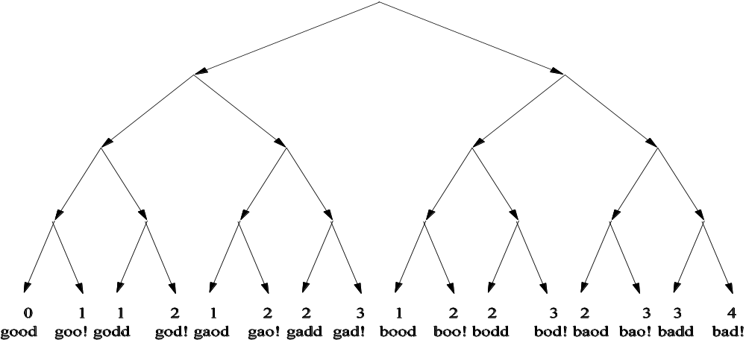

The Search Space
void top(char input[4])
{
int cnt = 0;
if (input[0] == ‘b’) cnt++;
if (input[1] == ‘a’) cnt++;
if (input[2] == ‘d’) cnt++;
if (input[3] == ‘!’) cnt++;
if (cnt >= 3) crash();
}
Use the scores to rank the next generation
Slide by David Molner

Slide 73
Major Issues in SE
How to terminate?
  Checking subsumption of symbolic states
How to counter path explosion?
  Compositional approaches
    Summaries (see SMART by Godefroid)
  State Merging
    Merge paths at control points by adding \/ between path conditions and make it the SMT solver’s problem
    Interesting new idea to compact according to variables (see http://www.eecs.berkeley.edu/Pubs/TechRpts/2014/EECS-2014-173.html)

Slide 74
Symbolic Execution with Abstract Subsumption Checking
(Spin 2006)
Symbolic state
  Represents a set of concrete states
State matching
  Subsumption checking between symbolic states
Symbolic state S₁ is subsumed by symbolic state S₂ iff
    set of concrete states represented by S₁ ⊆
    set of concrete states represented by S₂
Model checking
  Examine if a symbolic state is subsumed by previously stored symbolic state
  Continue or backtrack
Method handles
  Un-initialized data structures (lists, trees), arrays
  Numeric constraints
Slide by Corina Pasareanu

Slide 75
Symbolic State
E₁
left
right
E₁ > E₂ ∧
E₂ > E₃ ∧
E₂ < E₄ ∧
E₁ > E₄
E₂
left
right
E₃
E₄
Heap Configuration
Numeric Constraints
Notes:
Say what concrete trees it represents

Slide 76
Subsumption for Symbolic States
Two steps (same program counter):
Subsumption checking for heap configurations
  Obtained through DFS traversal of “rooted” heap configurations
    Roots are program variables pointing to the heap
  Unique labeling for “matched” nodes
  Considers only the heap shape, ignores numeric data
Subsumption checking for numeric constraints
  Heap subsumption is only a pre-requisite of state subsumption
  Check logical implication between numeric constraints
  Existential quantifier elimination to “normalize” the constraints
    Uses Omega library
Notes:
Same program counter

Slide 77
Subsumption for Heap Configurations
root
root
1:
1:
left
right
left
right
⊆
2:
2:
left
right
left
right
left
right
3:
4:
3:
4:
root
root
Unmatched!
left
right
⊆
left
right
⊇
left
right
left
right
Notes:
More general (represents more concrete heap configurations).
Blob – used as a wildcard

Slide 78
Subsumption for Numeric Constraints
Stored state:
1:
E₁
E₁ > E₂ ∧
E₂ > E₃ ∧
E₂ ≤ E₄ ∧
E₁ > E₄
Set of concrete
states represented
by stored state
2:
E₂
3:
E₃
4:
E₄
⊆
⇒
⊆
1:
E₁
E₁ > E₂ ∧
E₂ > E₃ ∧
E₂ < E₄ ∧
E₁ > E₄
New state:
Set of concrete
states represented
by new state
2:
E₂
3:
E₃
4:
E₄
Notes:
We handle only integer constraints

Slide 79
Subsumption for Numeric Constraints
Existential Quantifier Elimination
1:
E₁:V₁
Valuation:
E₁ = V₁ ∧ E₂ = V₄ ∧ E₃ = V₃ ∧ E₄ = V₅
PC:
V₁ < V₂ ∧ V₄ > V₃ ∧ V₄ < V₁ ∧ V₄ < V₅ ∧ V₆ < V₂ ∧ V₇ > V₂
2:
E₂:V₄
V₂
3:
E₃:V₃
4:
E₄:V₅
V₆
V₇
∃ V₁,V₂,V₃,V₄,V₅,V₆,V₇:
E₁ = V₁ ∧ E₂ = V₄ ∧ E₃ = V₃ ∧ E₄ = V₅ ∧ PC
simplifies to
E₁ > E₂ ∧ E₂ > E₃ ∧ E₂ < E₄ ∧ E₁ > E₄
Notes:
More tricks to implement subsumption – we can discuss off-line
Intuitively – we are only interested in the relative order of elements stored in matched nodes

Slide 80
Abstract Subsumption
Symbolic execution with subsumption checking
  Not enough to ensure termination
  An infinite number of symbolic states
Our solution
  Abstraction
    Store abstract versions of explored symbolic states
    Subsumption checking to determine if an abstract state is re-visited
    Decide if the search should continue or backtrack
  Enables analysis of under-approximation of program behavior
  Preserves errors to safety properties
Automated support for two abstractions:
  Shape abstraction for singly linked lists
  Shape abstraction for arrays

Slide 81
Abstractions for Lists and Arrays
Shape abstraction for singly linked lists
  Summarize contiguous list elements not pointed to by program variables into summary nodes
  Valuation of a summary node
    Union of valuations of summarized nodes
  Subsumption checking between abstracted states
    Same algorithm as subsumption checking for symbolic states
    Treat summary node as an “ordinary” node
Abstraction for arrays
  Represent array as a singly linked list
  Abstraction similar to shape abstraction for linked lists

Slide 82
Abstraction for Lists
Symbolic states
Abstracted states
1:
2:
3:
this
V₀
next
V₁
next
V₂
next
this
V₀
next
V₁
next
V₂
next
n
n
E₁ = V₀ ∧ E₂ = V₁ ∧ E₃ = V₂
PC: V₀ ≤ v ∧ V₁ ≤ v
PC: V₀ ≤ v ∧ V₁ ≤ v
Unmatched!
⊆
1:
2:
3:
this
V₀
next
V₁
next
V₂
next
V₃
next
this
V₀
next
{ V₁
, V₂ }
next
V₃
next
n
n
E₁ = V₀ ∧ (E₂ = V₁ ∨ E₂ = V₂) ∧ E₃ = V₃
PC: V₀ ≤ v ∧ V₁ ≤ v ∧ V₂ ≤ v
PC: V₀ ≤ v ∧ V₁ ≤ v ∧ V₂ ≤ v
Notes:
From the list example that I showed before

